Slide 1


Online Retail Management System
Group Members:
Pravin Dhuri (002138314)
Vipin Mamidi (001582139)
Xingyu Huang (001582498)
Harshil Pradhan (002114690)
Riti Gawade (001059647)

Slide 2

Objectives
To build a database management system that contains all product related data, customer profiles, sales data, order details, shipping status
To maintain the information of inventory and logistics related data
Manage different products & category in the store
Database will keep track of inventory & stolen products
To analyze the product’s popularity, delivery status, through visualizations

Slide 3
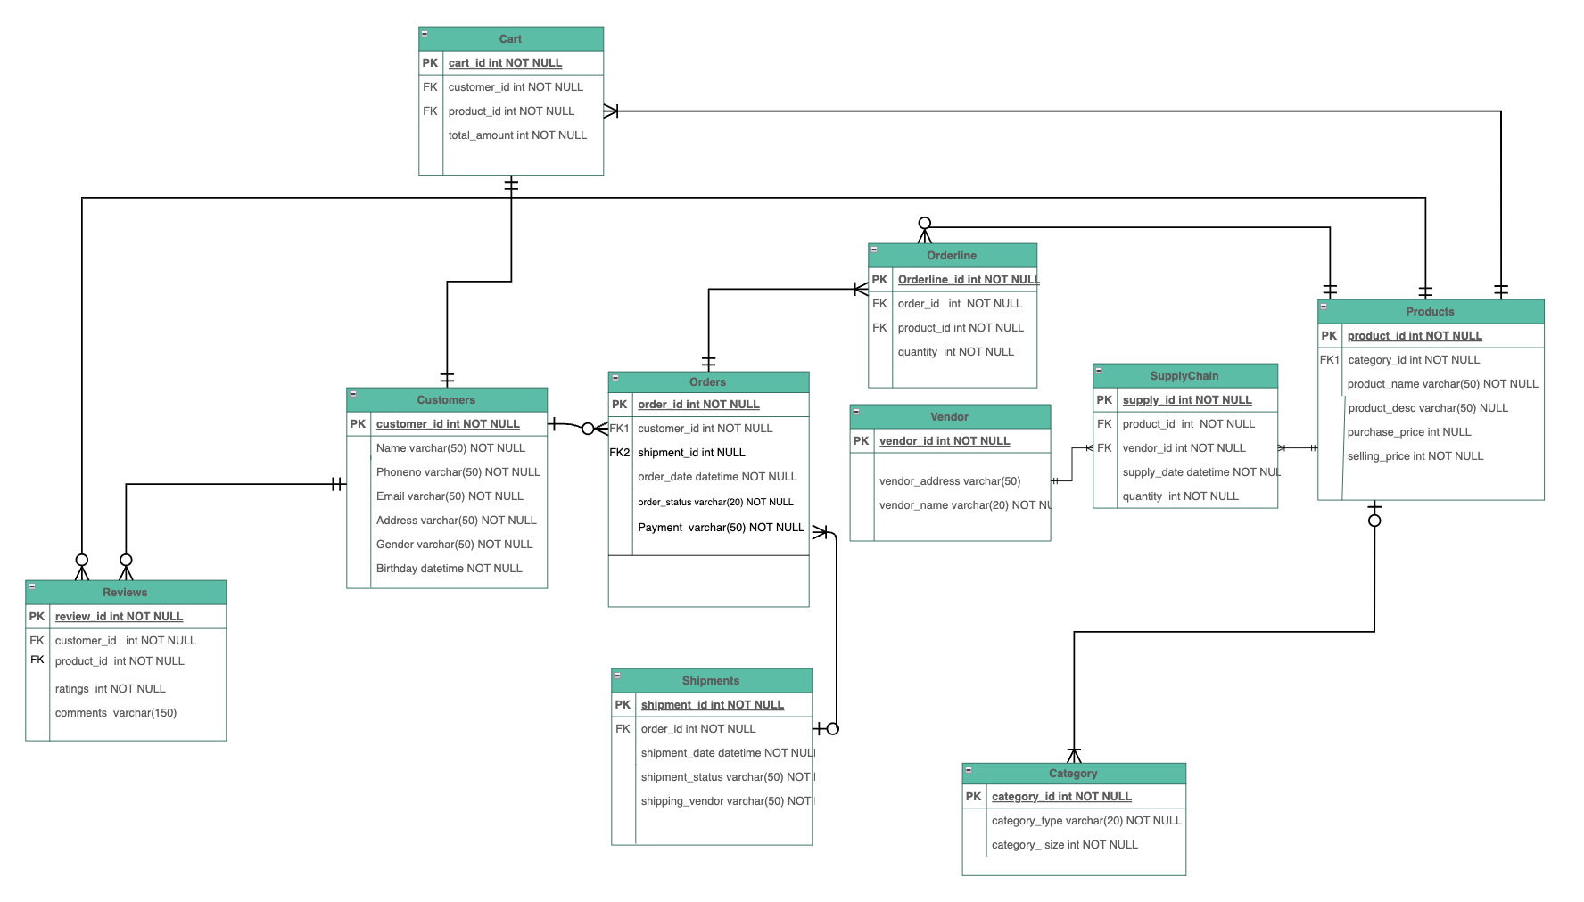
Entity Relationship Diagram

Slide 4
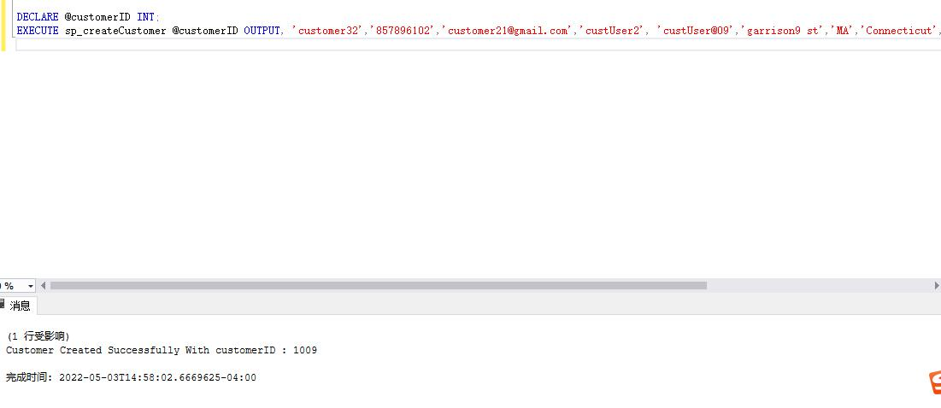
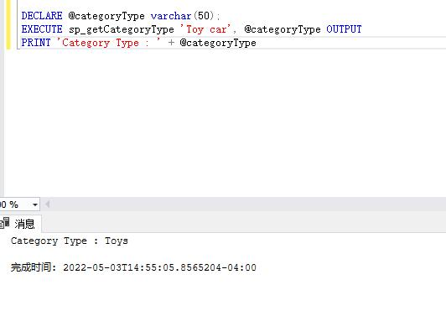
Stored Procedures
Stored Procedure to get Category Type
Stored Procedure to create Customer

Slide 5
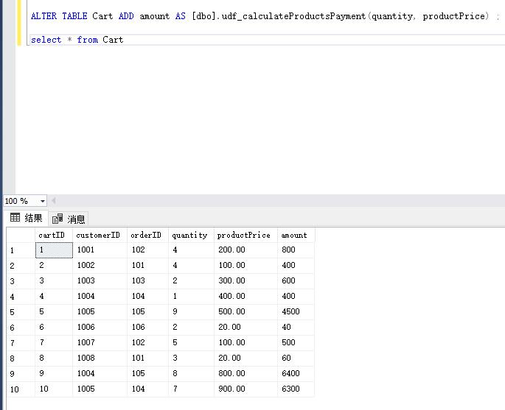
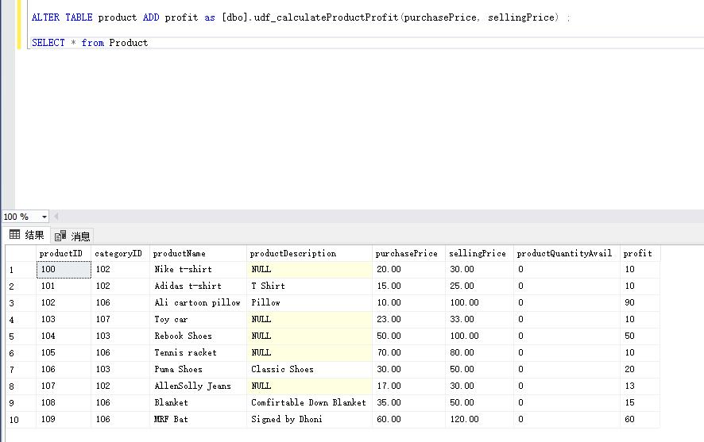
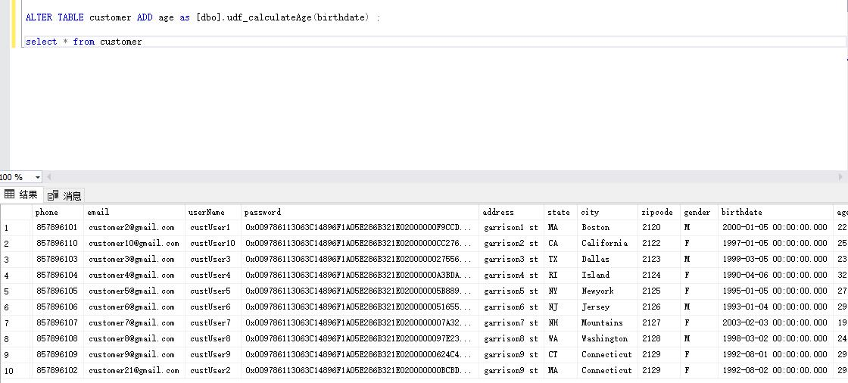
Functions
Calculating Product Payment
Calculating Product Profit
Calculating Age

Slide 6
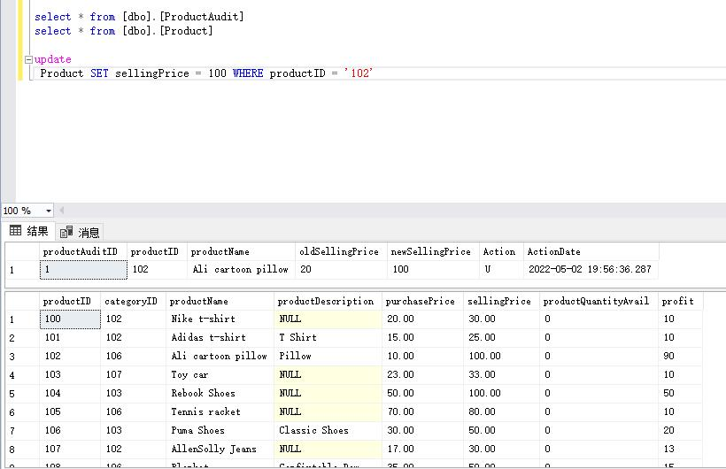
triggers

Slide 7
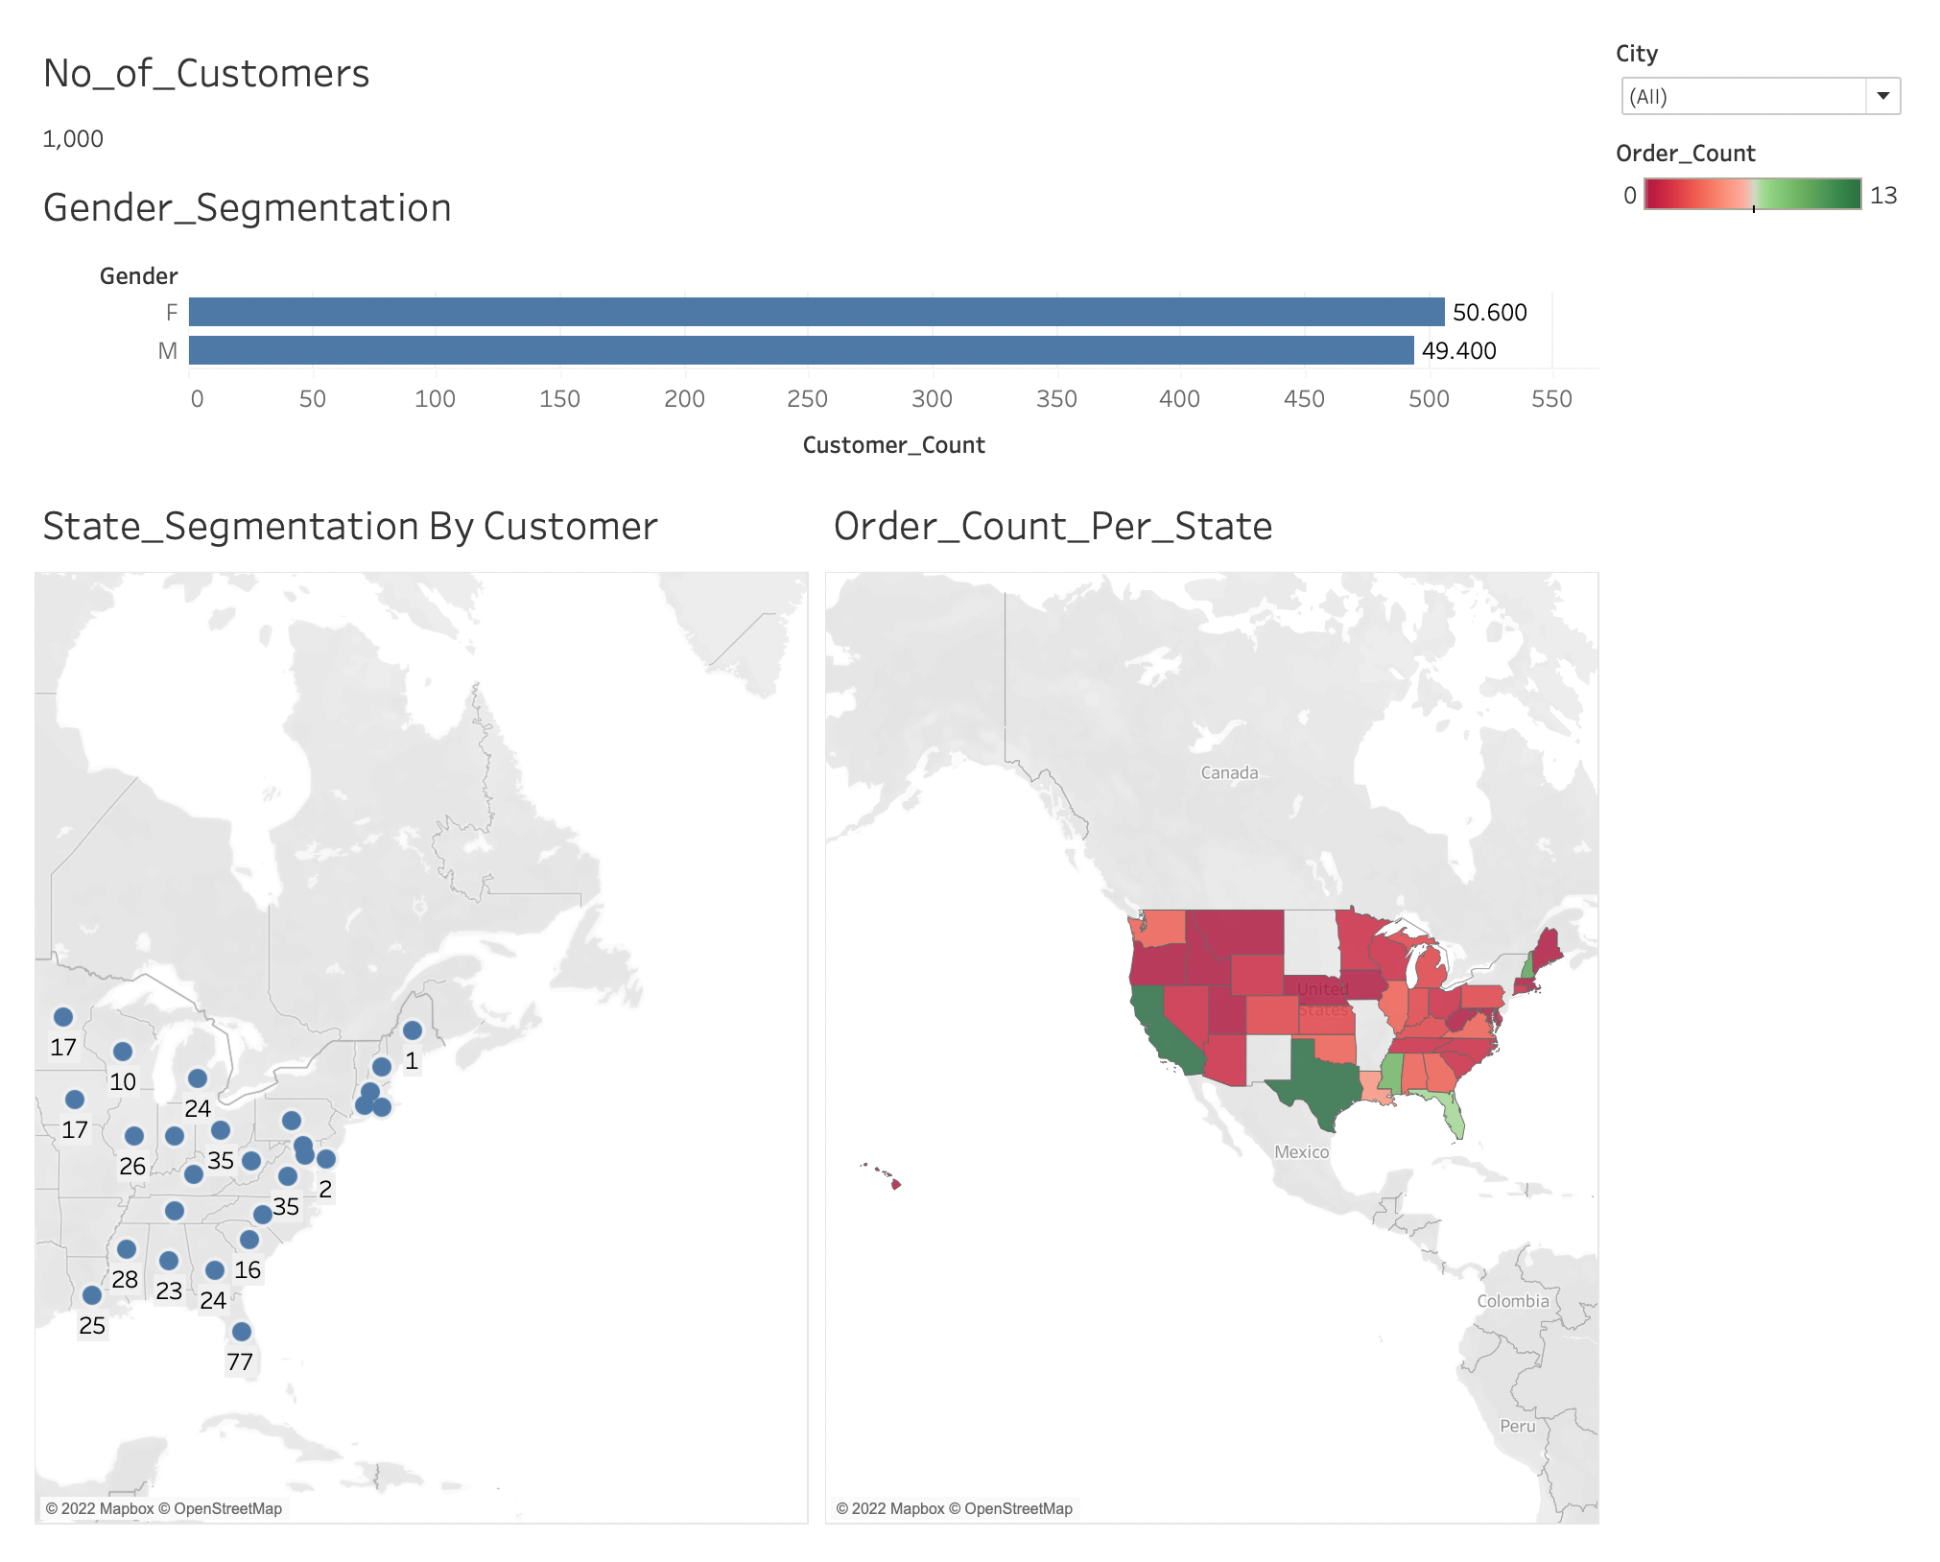
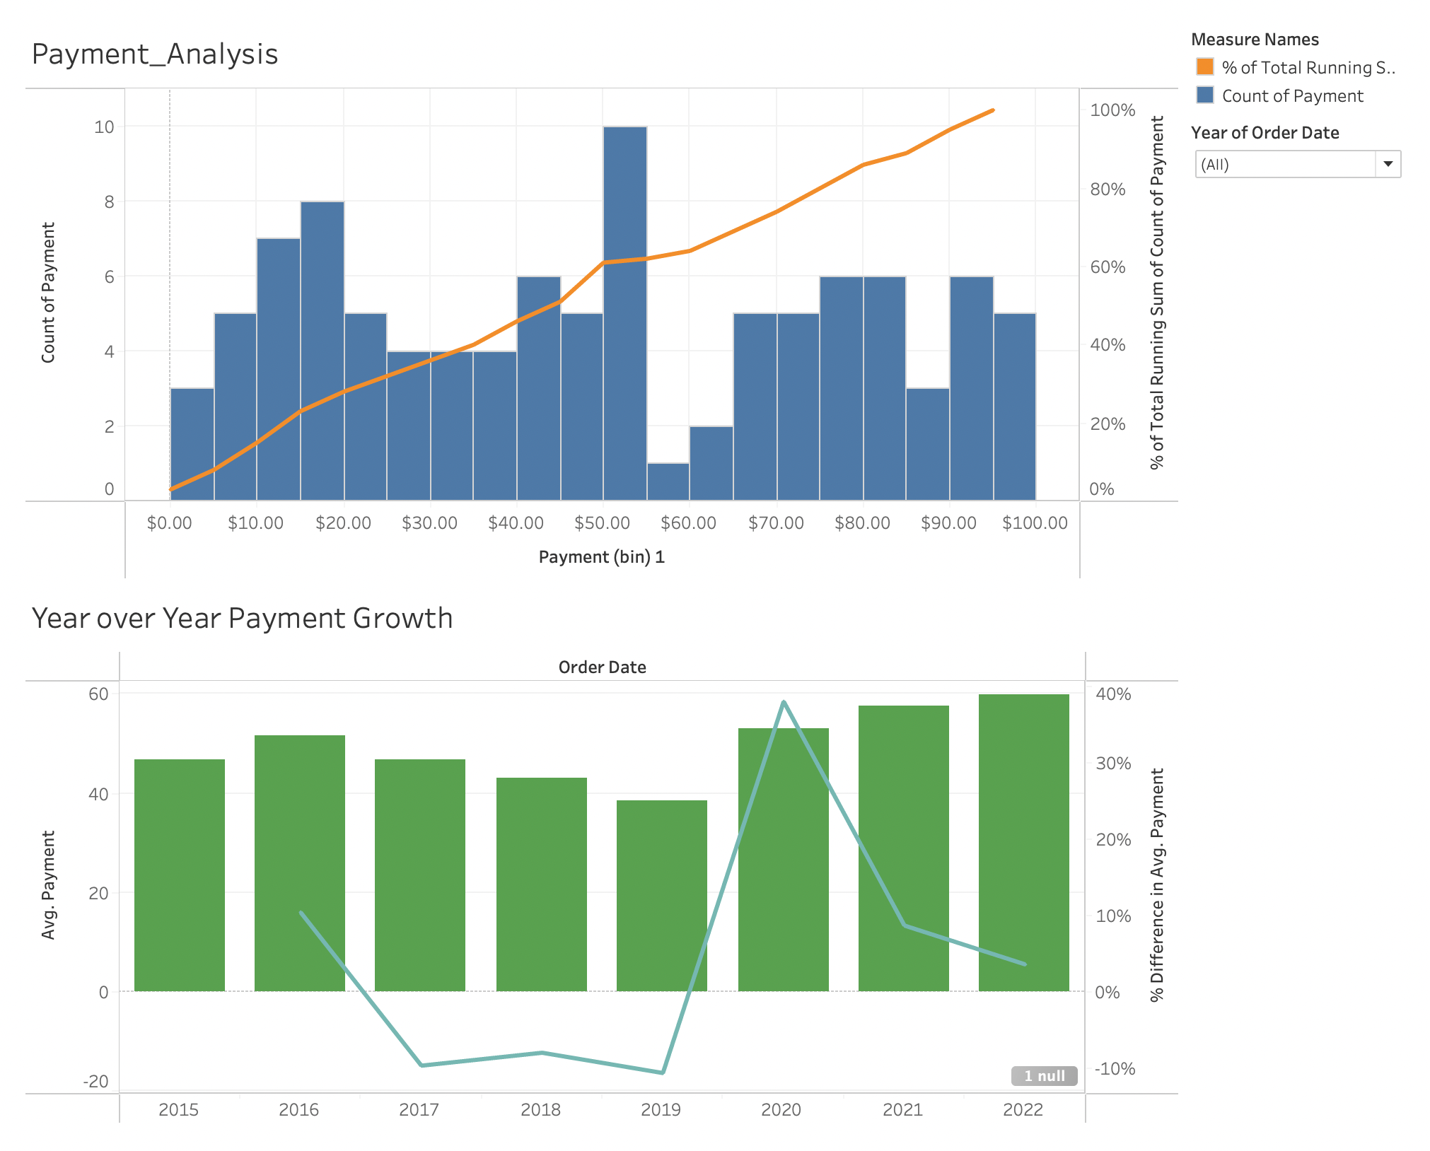
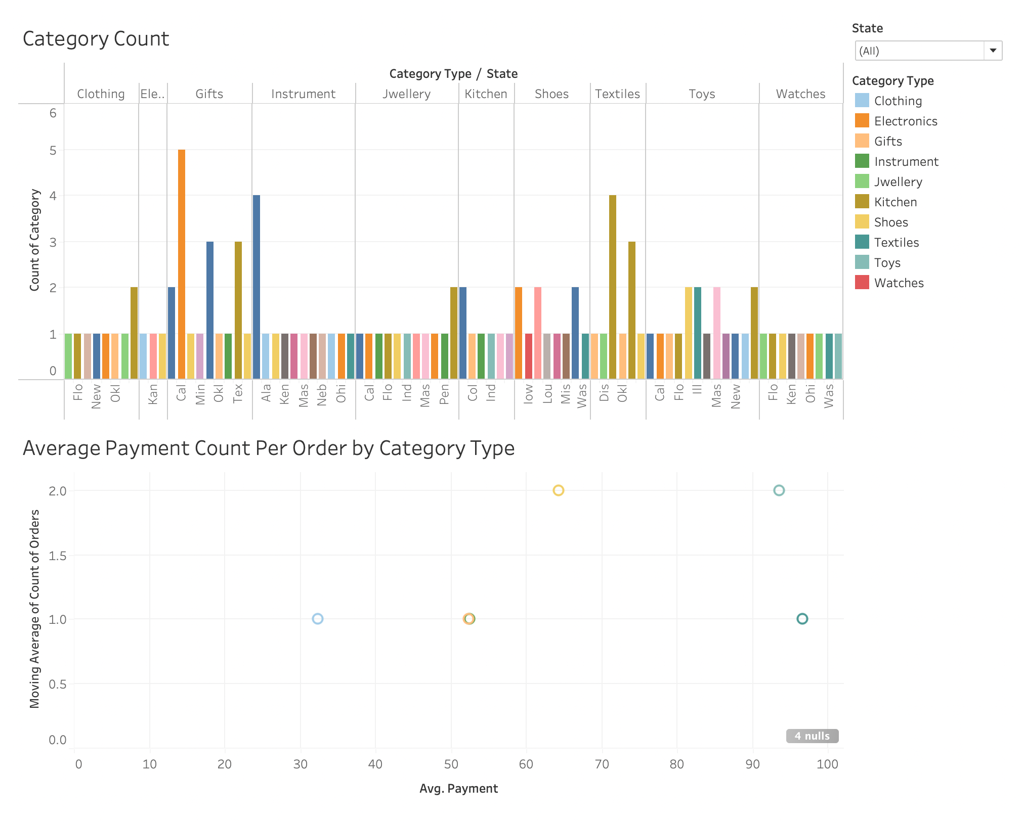
Data Visualization

Slide 8

Thank You

